Slide 1
Prediction of responsive companies based on consumer complaints
Chinmay Patane
Monalisa Singh
Zi Yang
Rishi Sai reddy Sudireddy

Slide 2
Index
•Context
•Who, What and How
•Three Minutes Sto
•The Big Idea

Slide 3
Context
Finding the companies with best customer satisfaction
Understanding financial institution behaviour
Visualizations

Slide 4
Data and attributes
•Collected this dataset from https://catalog.data.gov/dataset
•Total number of instances in this dataset was around 1 million
•following are the attributes included in dataset:
1.Date received 10.Date sent to company narrative
2.Product 11. consumer complaint
3.Sub-product 12. company public response
4.Issue 13 company
5.Sub-issue 14. state
6.zip code 15. company response to consumer
7.Tags 16. timely response
8.Consumer consent provided 17. consumer disputed
9.Submitted via 18. complaint ID

Slide 5
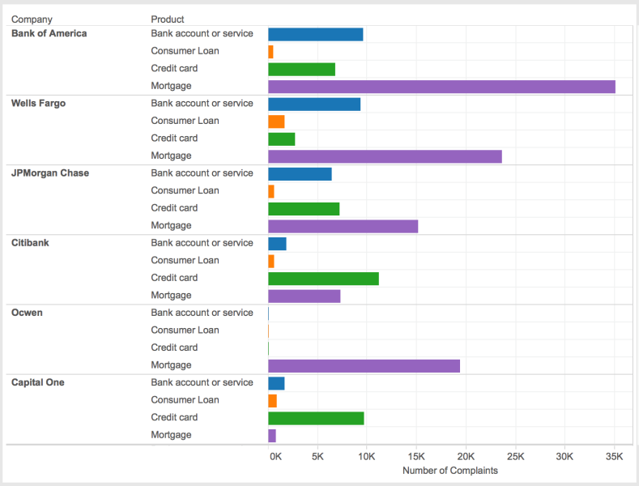

Slide 6
Who What and How
Whom are we targeting?
The banks/financial institutions who have poor performance compared to industry leaders
What are we going to solve?
Approach the companies with strategies used by best performing companies and help them reach their potential with minimum resources
How ?
Using consumer complaints and the existing data , making models and back testing the approaches.

Slide 7
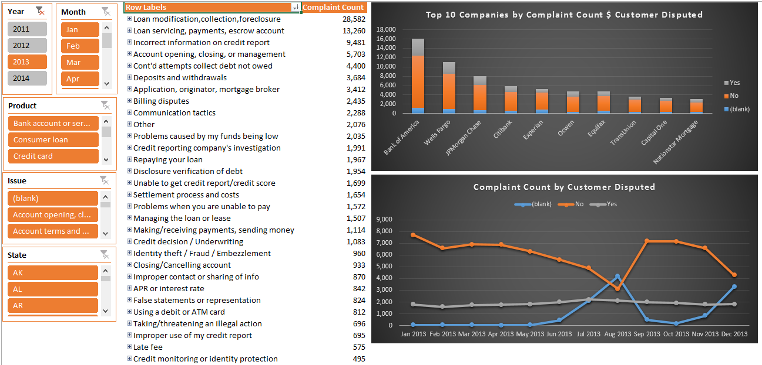

Slide 8
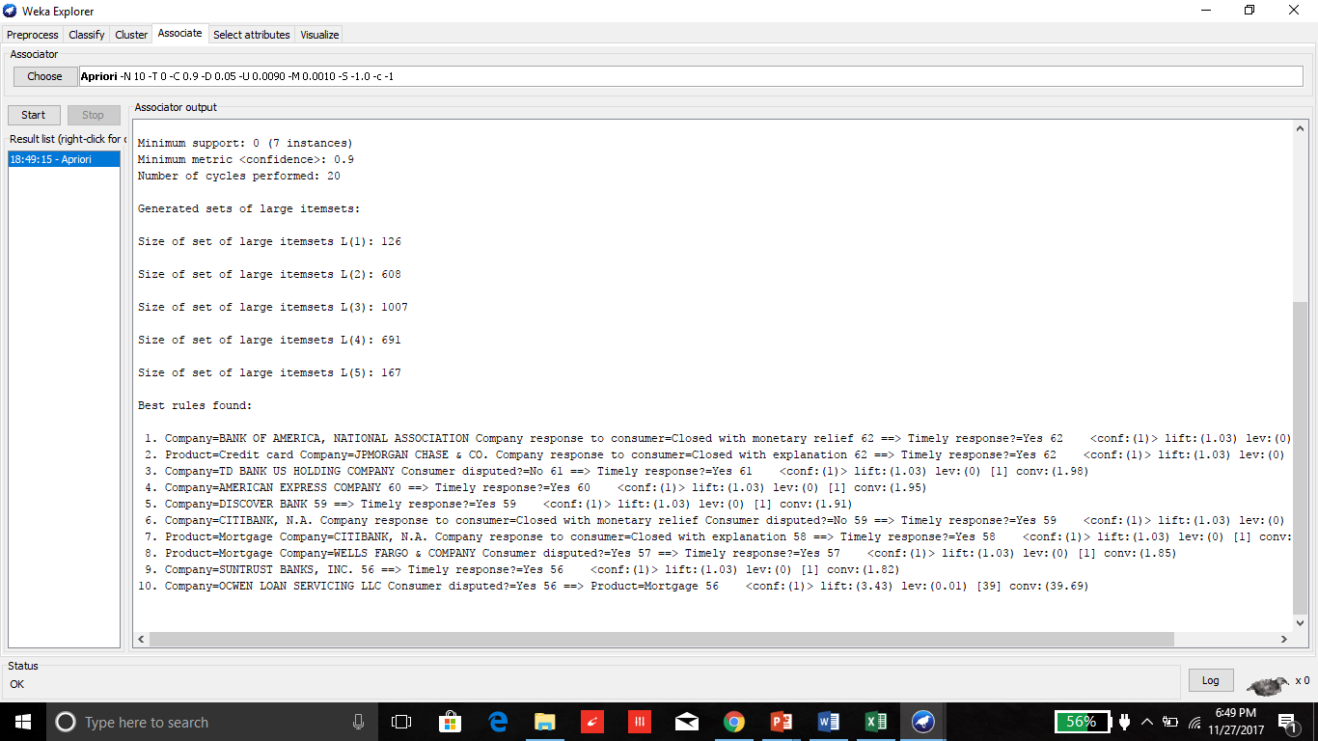

Slide 9
The Big Idea
Using Analytics to capture characteristics of successful companies for churn reduction in weaker companies and uplift customer satisfaction.

